Slide 1


Foot & Ankle Anatomy
PT4050 / PT7001
Paul Starrs
p.starrs@londonmet.ac.uk

Slide 2
LEARNING OUTCOMES
Describe the anatomical features (articular surface, ligaments etc.) of the ankle joint and know their importance in relation to its stability
Describe the movements of the ankle joint
Give an account of forced inversion and eversion injuries
Give an outline of the subtalar and mid-tarsal joints
Explain the condition of clubfoot
Describe the muscles that move the ankle, subtalar and mid-tarsal joints, including their nerve supply and attachments

Slide 3
LEARNING OUTCOMES
Describe the joints of the midfoot and forefoot
Outline the basis of hallux valgus
Give an account of the arches of the foot, and state the importance of the tendons and ligaments during standing and walking
Appreciate the principles of the organisation of the intrinsic muscles of the foot
Identify the structures involved in the extensor mechanism of the toes
Give an account of the neurovascular structures in the foot and know the cutaneous distribution of the nerves

Slide 4
LEARNING ANATOMY
Learn the basic anatomical terms i.e. superior, inferior, proximal, distal, medial, lateral, etc.
Learn the names of the bones and joints, as well as the movements available at each of the joints and what these movements look like (from a human anatomy textbook)
Revise the names of the bony landmarks around each of the joints (from a human anatomy textbook)
Revise the names of the muscles around each of the joints, as well as their origin, insertion and 'actions' (from a human anatomy textbook)

Slide 5
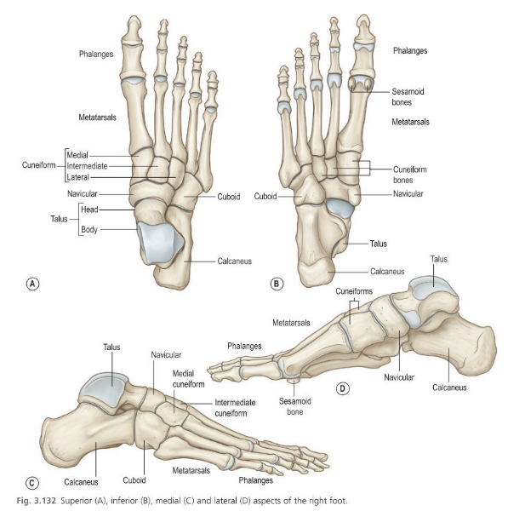
BONES OF THE FOOT & ANKLE

Slide 6
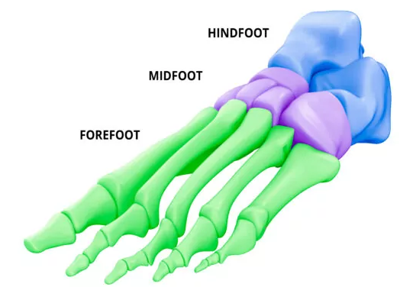
THE FOOT & ANKLE
The primary functions of the foot are to provide a stable platform of support to attenuate impact loading and to assist in the efficient forward propulsion of the body
Composed of multiple, mobile and semirigid articulations that afford foot conformity to varying surface
To accomplish these tasks, the foot is made up of three sections:
  Hindfoot
  Midfoot,
  Forefoot

Slide 7
Hindfoot

Slide 8
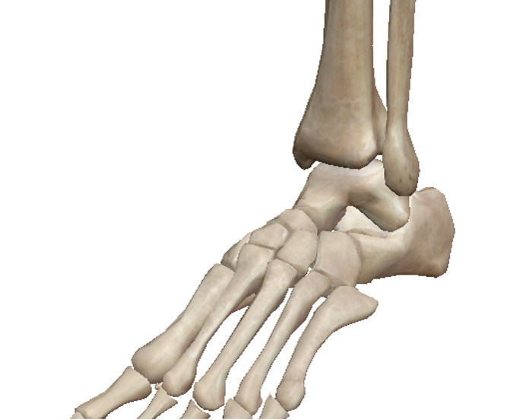
TALOCRURAL JOINT
The ankle joint, aka the talocrural joint, is made up of three bones:
  FIBULA
  TIBIA
  TALUS
TIBIA
FIBULA
TALUS

Slide 9
TALOCRURAL JOINT
The articular surfaces of the talocrural joint are the:
  Distal end of the FIBULA (specifically the lateral malleolus)
  Distal end of the TIBIA (medial malleolus and tibial plafond)
  Dome of the TALUS
FIBULA and TIBIA are concave, whereas, TALUS is convex
TIBIA
FIBULA
TALUS

Slide 10
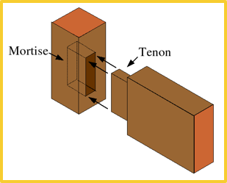
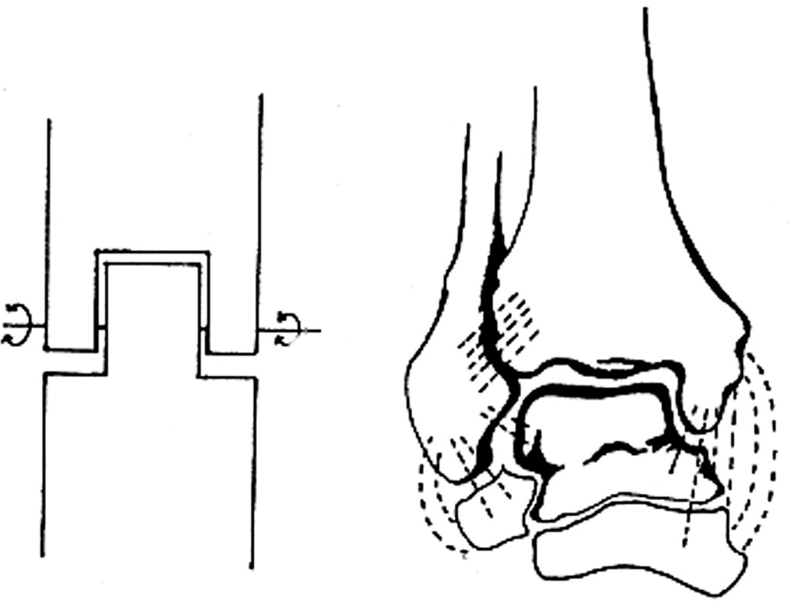
TALOCRURAL JOINT
Synovial hinge joint which permits one degree of movement
The appearance of the joint is a likened to a mortise and tenon

Slide 11
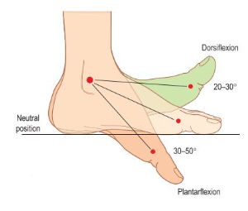
TALOCRURAL JOINT
Two movements:
  DORSIFLEXION
  PLANTARFLEXION
The dome of the talus is wider anteriorly than it is posteriorly. As such, the talus becomes firmly wedged within the mortise in dorsiflexion

Slide 12
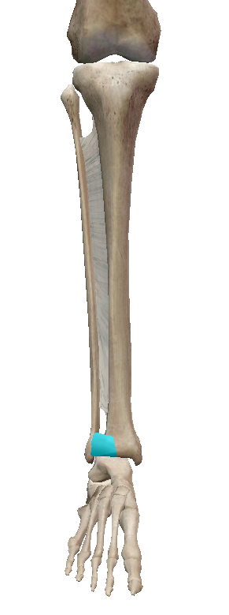
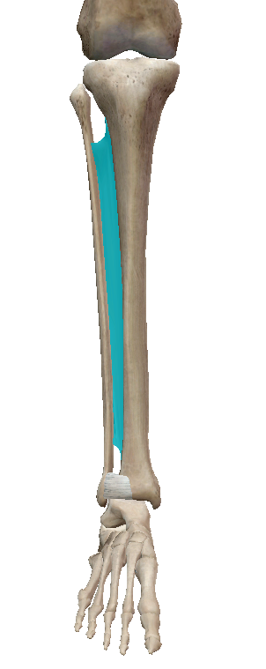
DISTAL TIB-FIB JOINT
The tibia and fibular also create a joint, at both the proximal and distal ends, of the bones
Distally, they are connected by the tibio-fibular ligament both anteriorly and posteriorly
The interosseous membrane, or the syndesmosis, runs the length of the shafts and stabilise the bones

Slide 13
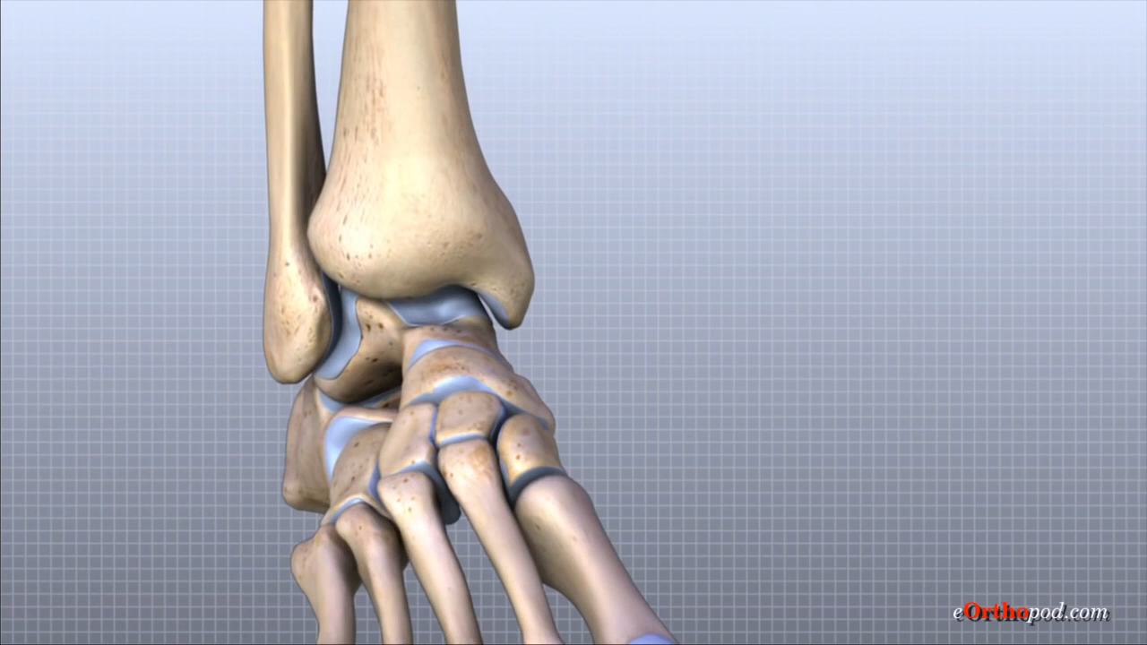
DISTAL TIB-FIB JOINT

Slide 14
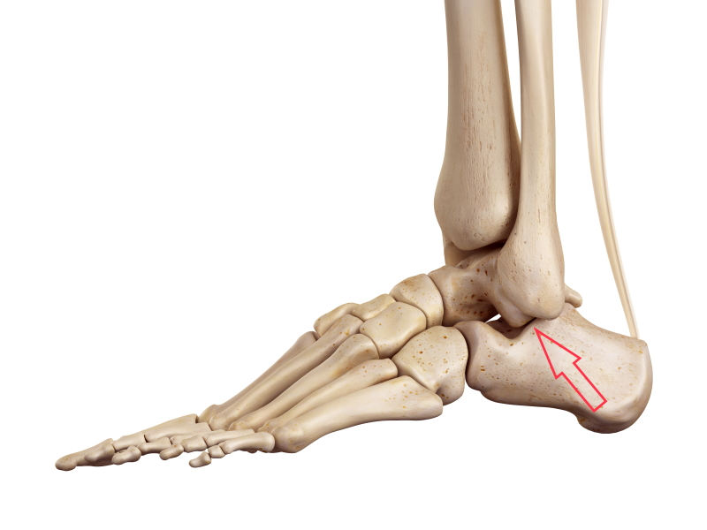
SUBTALAR JOINT
The talocalcaneal articulation is referred to as the subtalar joint
The articular surfaces of the subtalar joint are the:
  Inferior surface of the TALUS
  Superior surface of the CALCANEUS
TALUS
CALCANEUS

Slide 15
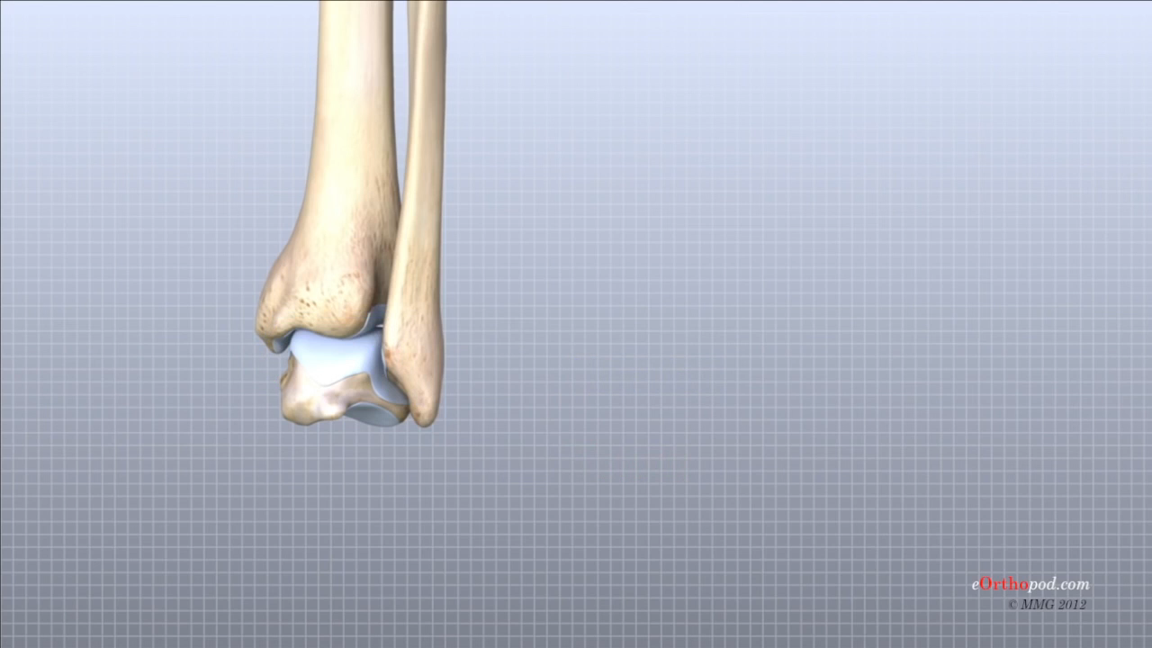
SUBTALAR JOINT

Slide 16
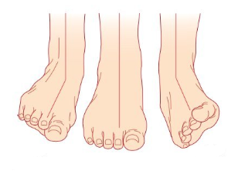
SUBTALAR JOINT
Two movements:
  INVERSION
  EVERSION

Slide 17

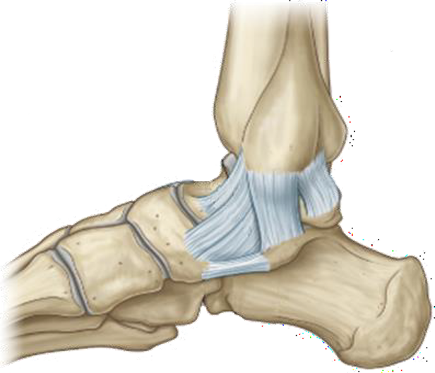
MEDIAL LIGAMENTS
The medial aspect of the talocrural joint is stabilised by the Deltoid ligament complex
Resist excessive subtalar eversion

Slide 18
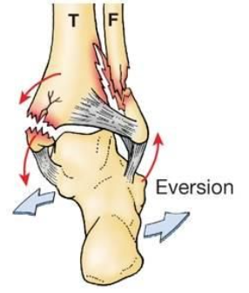
FORCE EVERSION INJURIES
Not as common as forced inversion injuries as the lateral malleolus extends further distally than the medial malleolus

Slide 19
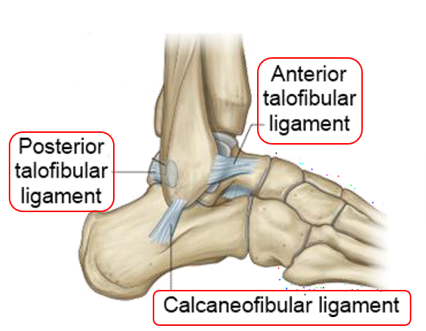
LATERAL LIGAMENTS
The lateral aspect of the talocrural joint is stabilised by the:
  ANTERIOR TALOFIBULAR LIGAMENT
  POSTERIOR TALOFIBULAR LIGAMENT
  CALCANEOFIBULAR LIGAMENT
Resist excessive subtalar inversion

Slide 20

FORCED INVERSION INJURIES

Slide 21
Midfoot

Slide 22
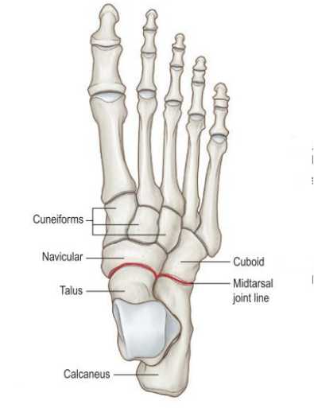
MID-TARSAL JOINTS
The midfoot contains the small, angular navicular, cuneiforms (medial, intermediate, and lateral), and cuboid bone
The midfoot makes up slightly more than one sixth of the overall length of the foot
Little movement occurs within the midfoot articulations

Slide 23
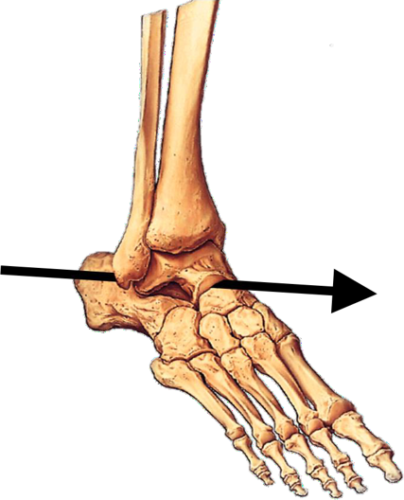
AXIS OF THE MIDFOOT

Slide 24
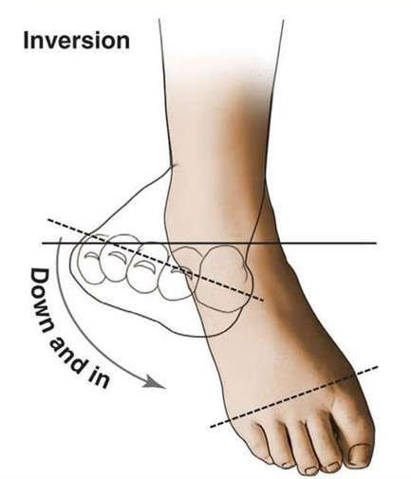
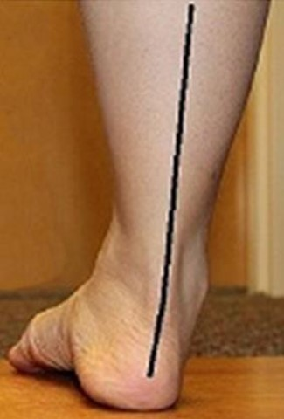
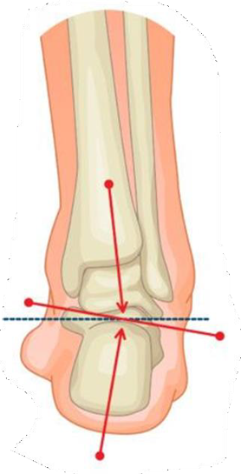
SUPINATION OF THE FOOT

Slide 25
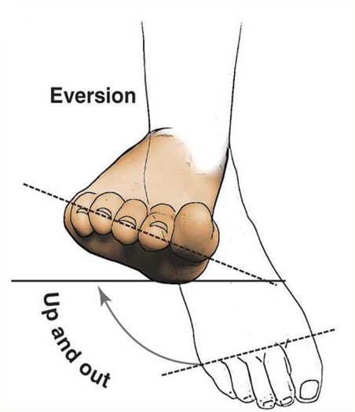
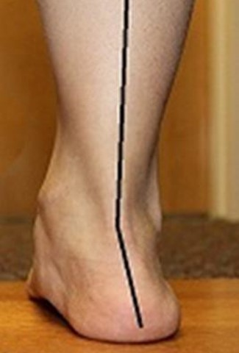
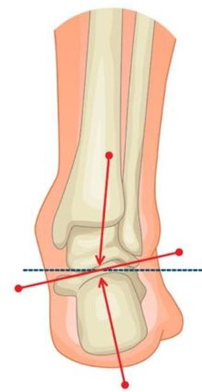
PRONATION OF THE FOOT

Slide 26

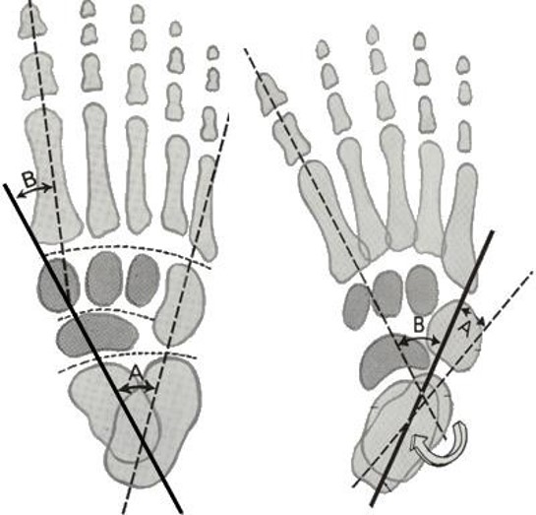
TALIPES EQUINOVARUS AKA CLUBFOOT

Slide 27
Forefoot

Slide 28
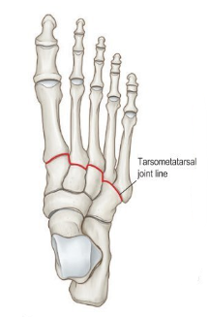
FOREFOOT
The forefoot represents the remaining one-half of the overall length of the foot
It is composed of miniature long bones - 5 metatarsals and 14 phalanges
These articulations of the forefoot are hinge / modified hinge joints
Their stability is primarily due to medial and lateral ligament
Volarly, the interphalangeal joints are stabilized against excessive dorsiflexion by firm volar ligaments called plates

Slide 29
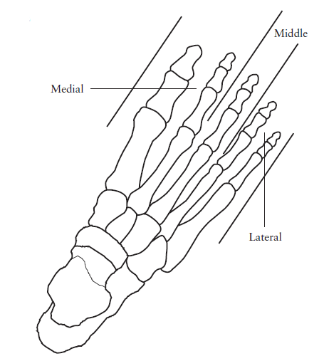
FOREFOOT
The digits of the foot can be:
  Numbered
  Divided into three columns
Medial digit (1st) is the largest. It is more than twice the dimension of any of the other digits. This reflects its greater importance in weight-bearing and push-off activity
Middle (3rd) digit represents the stable central column of the foot
Lateral two digits (4th & 5th) are progressively more capable of movement

Slide 30
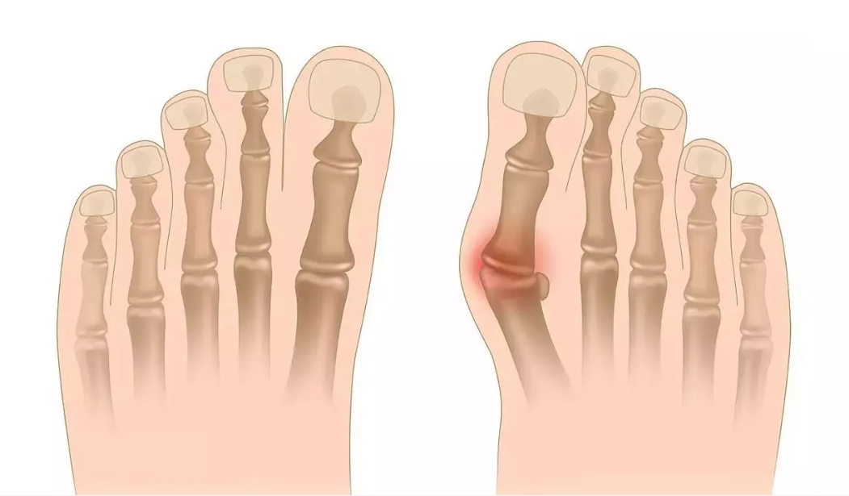
HALLUX VALGUS

Slide 31

QUIZ

Slide 32
Muscles of the Ankle

Slide 33
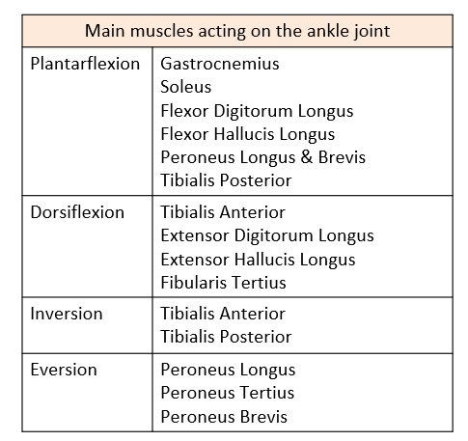
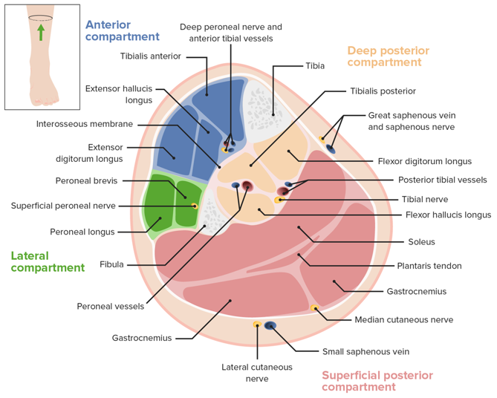
MUSCLES OF THE ANKLE

Slide 34
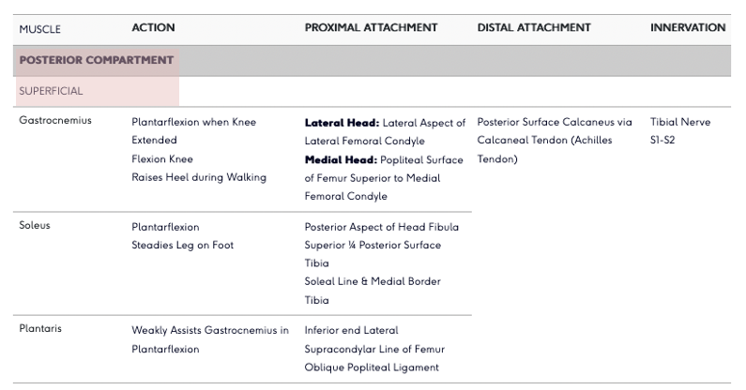
MUSCLES THAT PLANTARFLEX

Slide 35
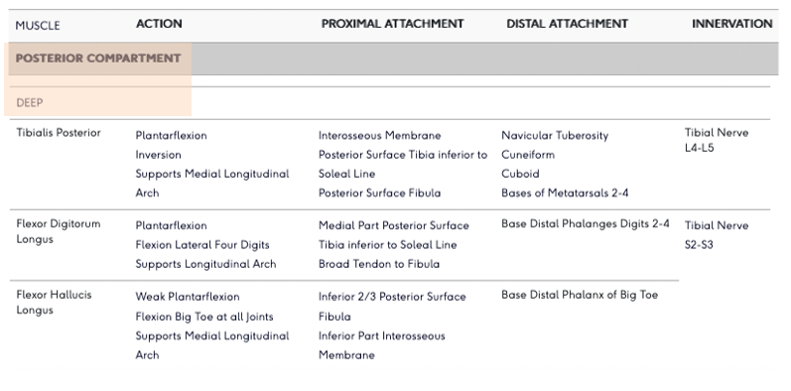
MUSCLES THAT PLANTARFLEX

Slide 36
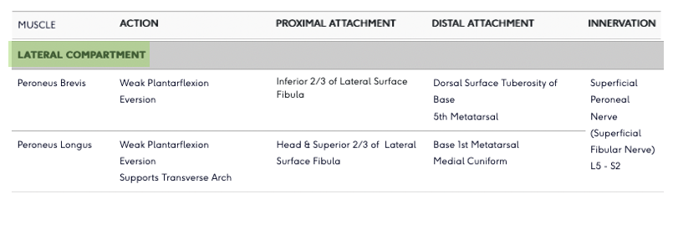
MUSCLES THAT PLANTARFLEX

Slide 37

ACHILLES TENDON RUPTURE

Slide 38
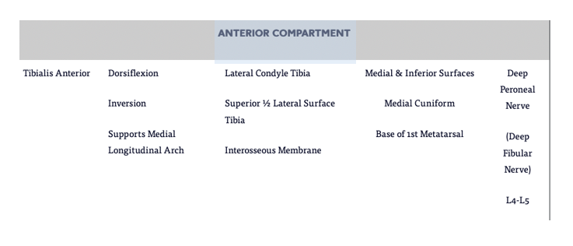
MUSCLES THAT DORSIFLEX

Slide 39
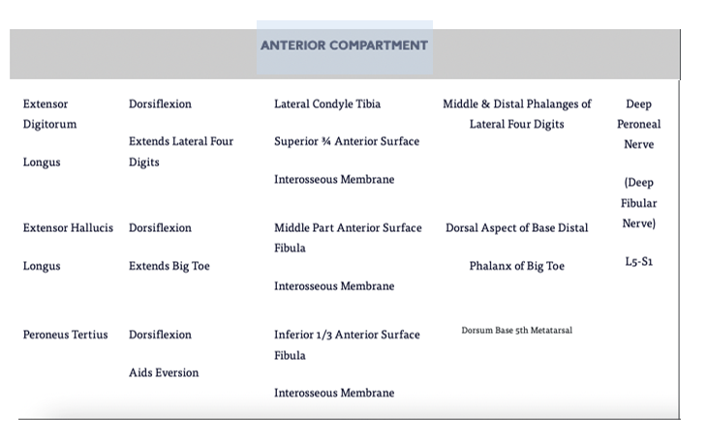
MUSCLES THAT DORSIFLEX

Slide 40
QUIZ

Slide 41

ANY QUESTIONS?

Slide 42

BREAK

Slide 43
Arches of the foot

Slide 44
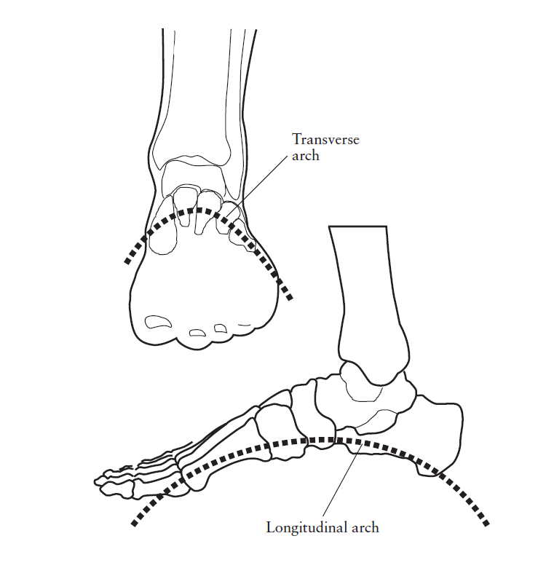
ARCHES OF THE FOOT
There are three arches of the foot:
  Medial longitudinal arch
  Lateral longitudinal arch
  Transverse arch
They provide shock absorption during locomotion and help to distribute load across the foot

Slide 45
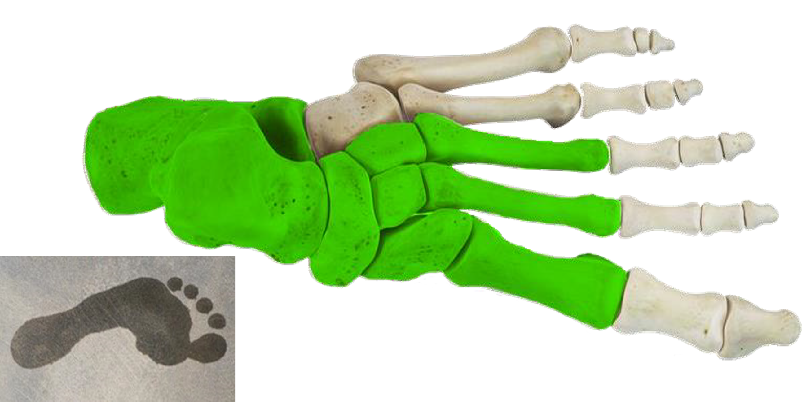
MEDIAL LONGITUDINAL ARCH

Slide 46
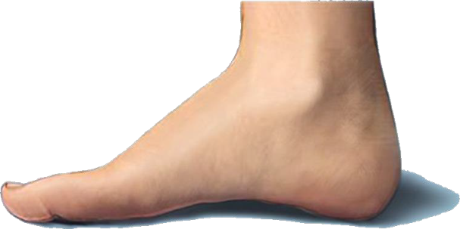
MEDIAL LONGITUDINAL ARCH

Slide 47
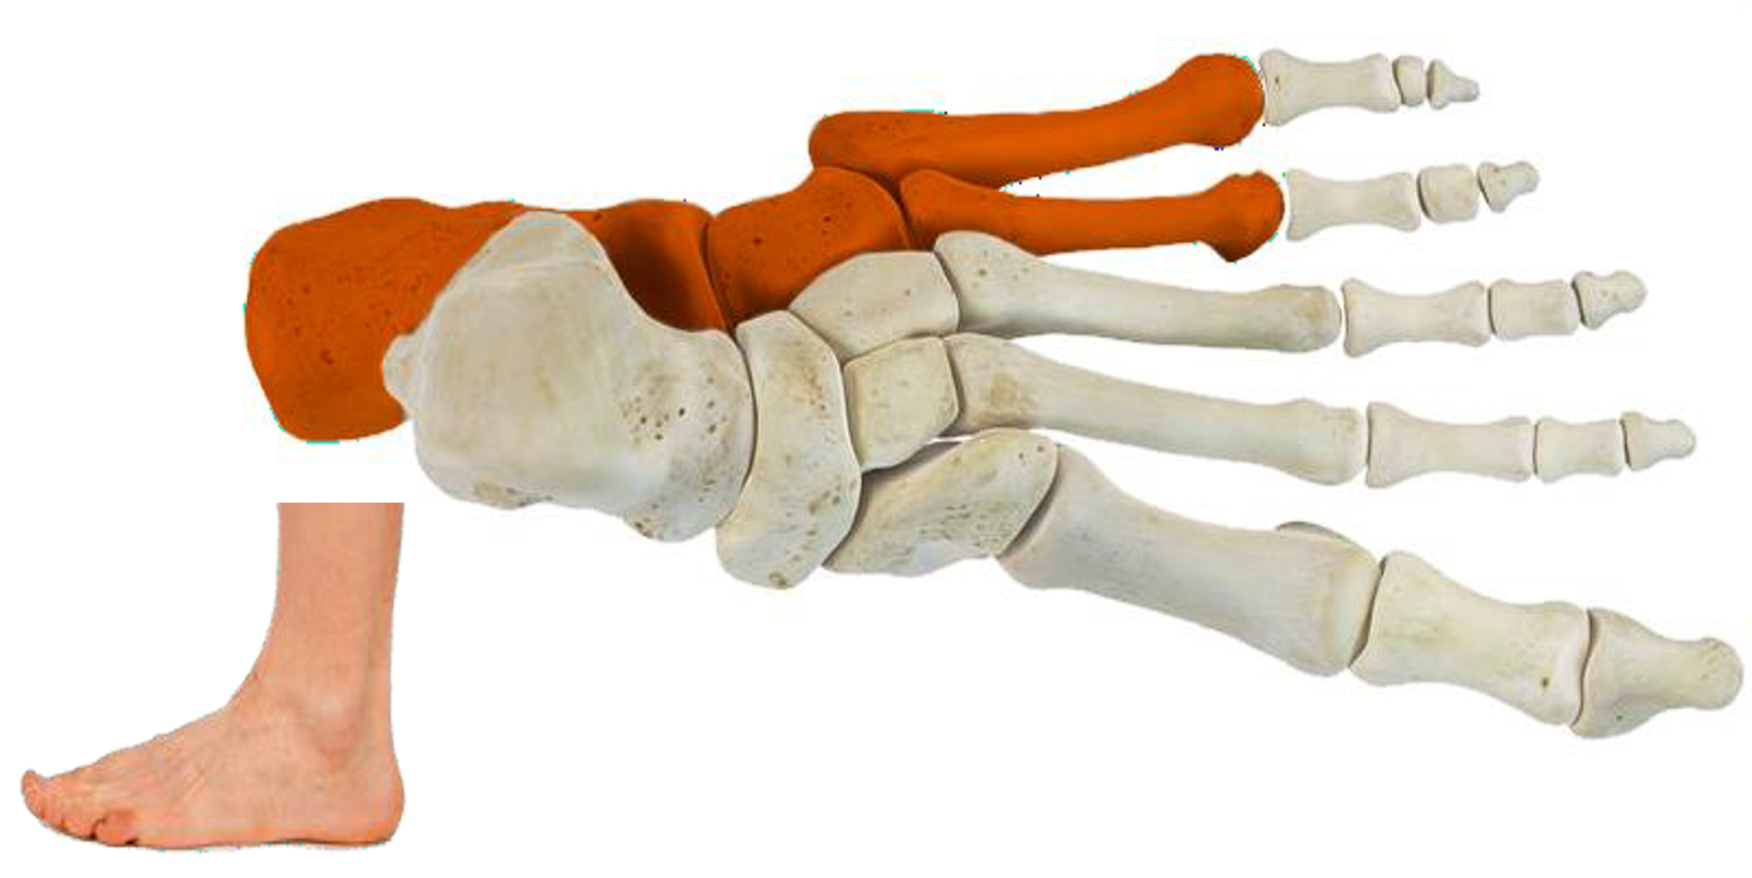
LATERAL LONGITUDINAL ARCH

Slide 48
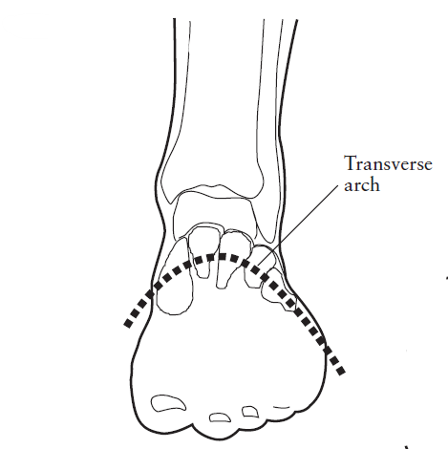
TRANSVERSE ARCH
The transverse arch results from:
  the shape of the tarsal bones in the distal row, and
  the metatarsal bases
The intermediate cuneiform is the ‘keystone’
Distributes load in the coronal plane

Slide 49
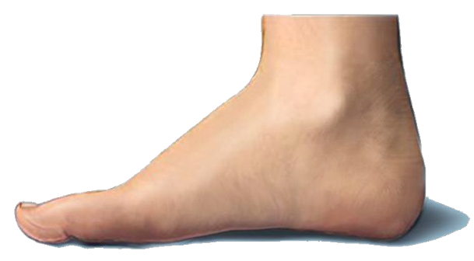
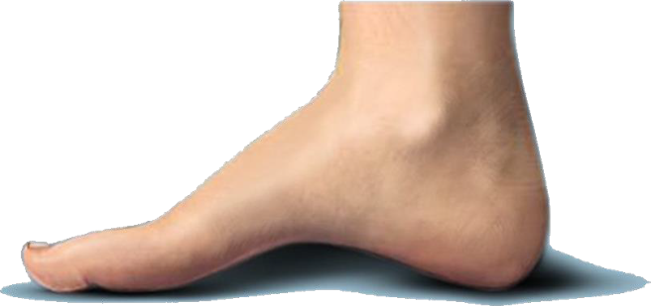
PES PLANUS / CAVUS

Slide 50
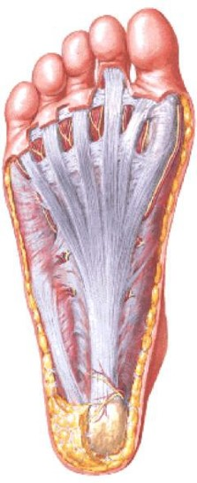
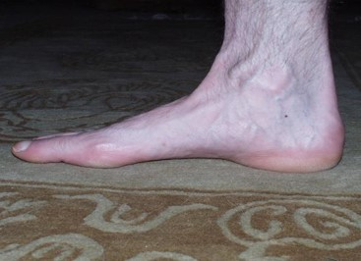
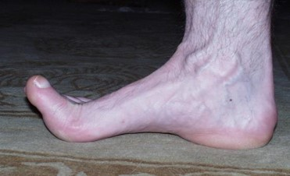
ARCH SUPPORT – PLANTAR FASCIA

Slide 51
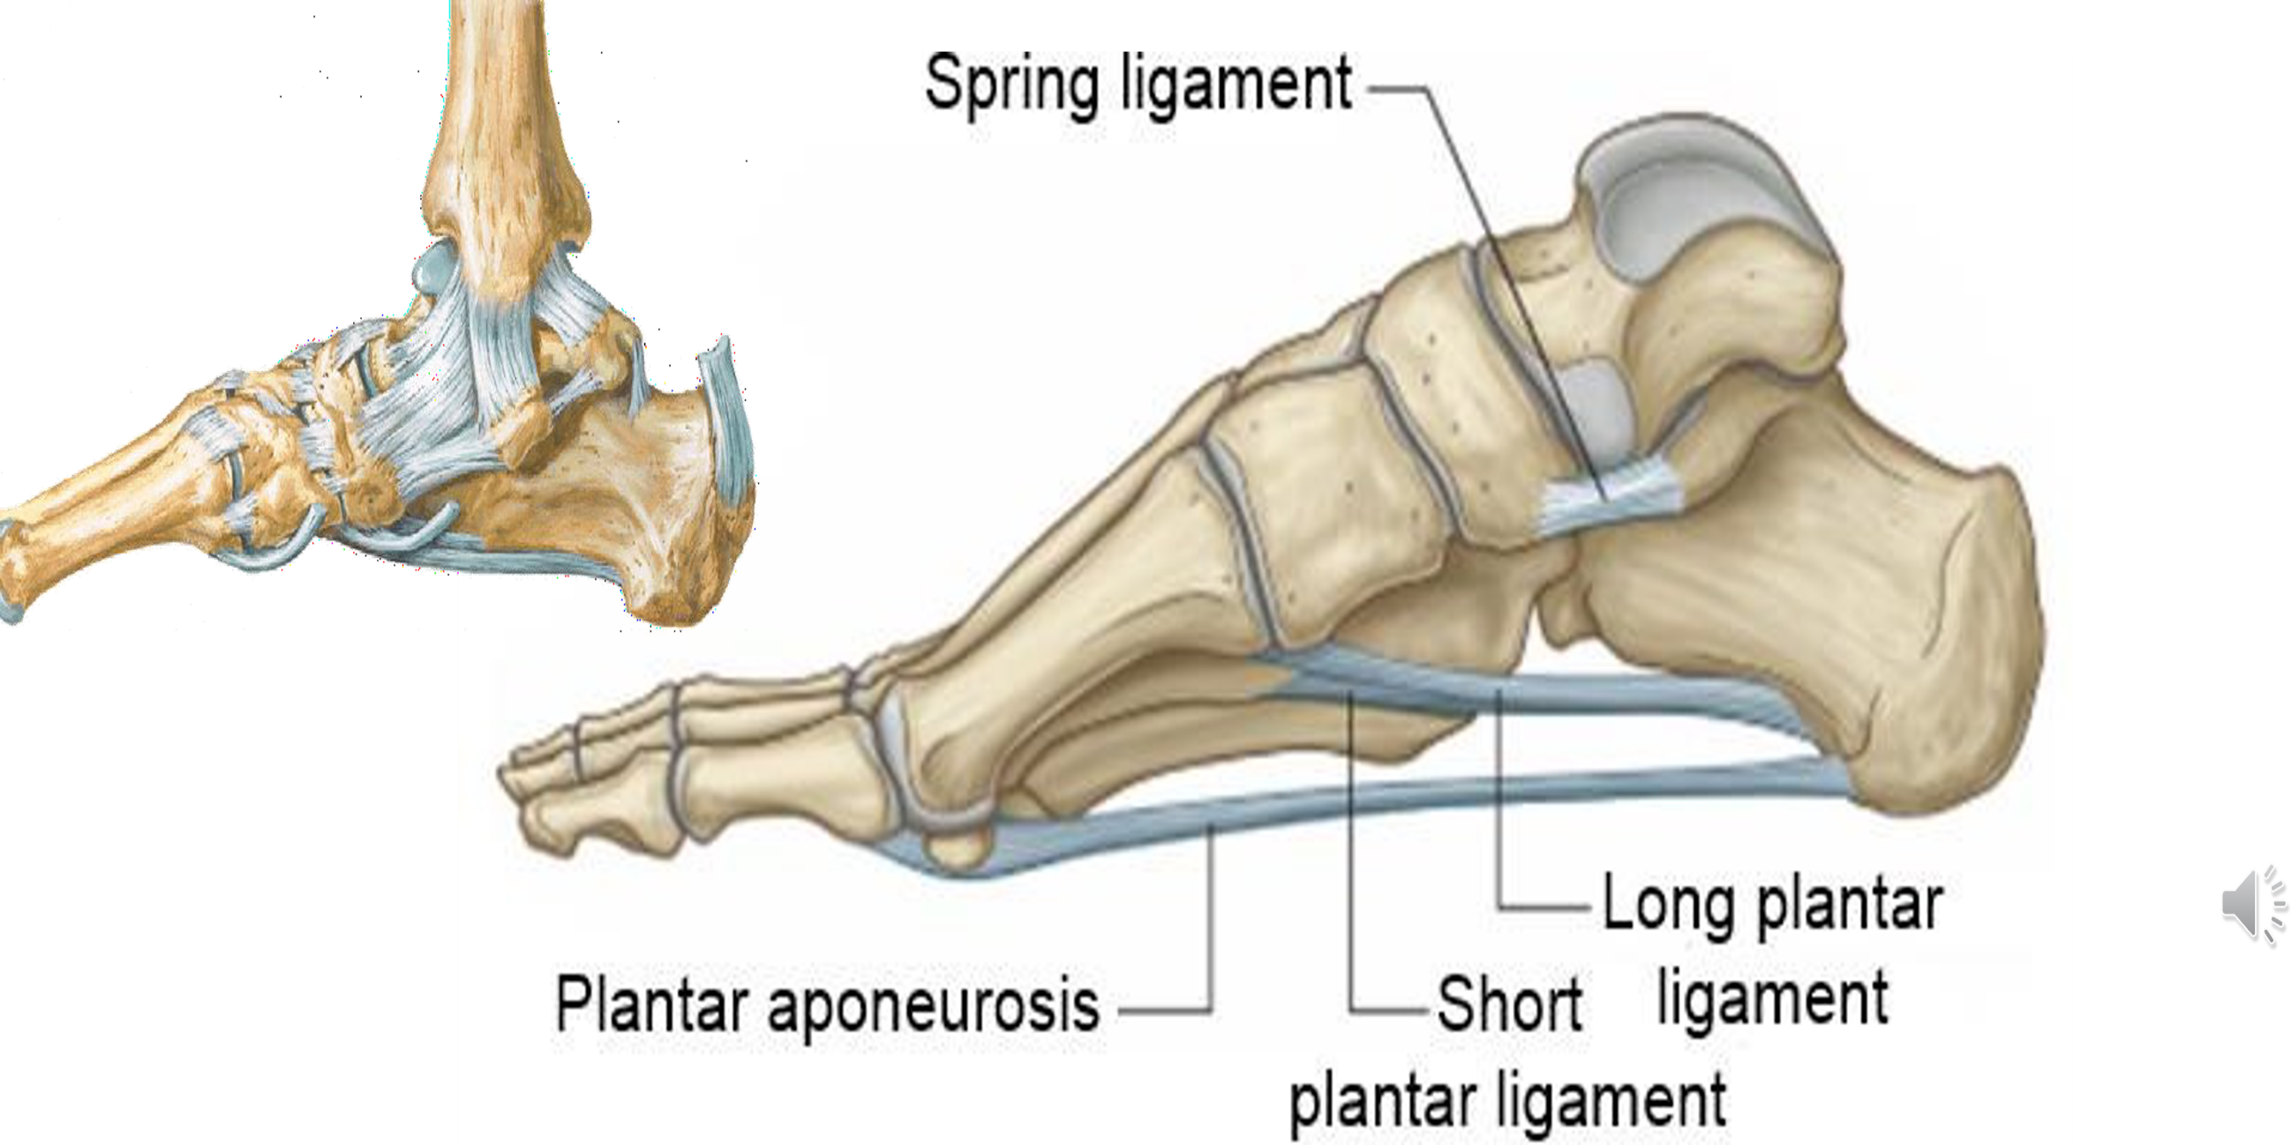
ARCH SUPPORT – LIGAMENTS

Slide 52
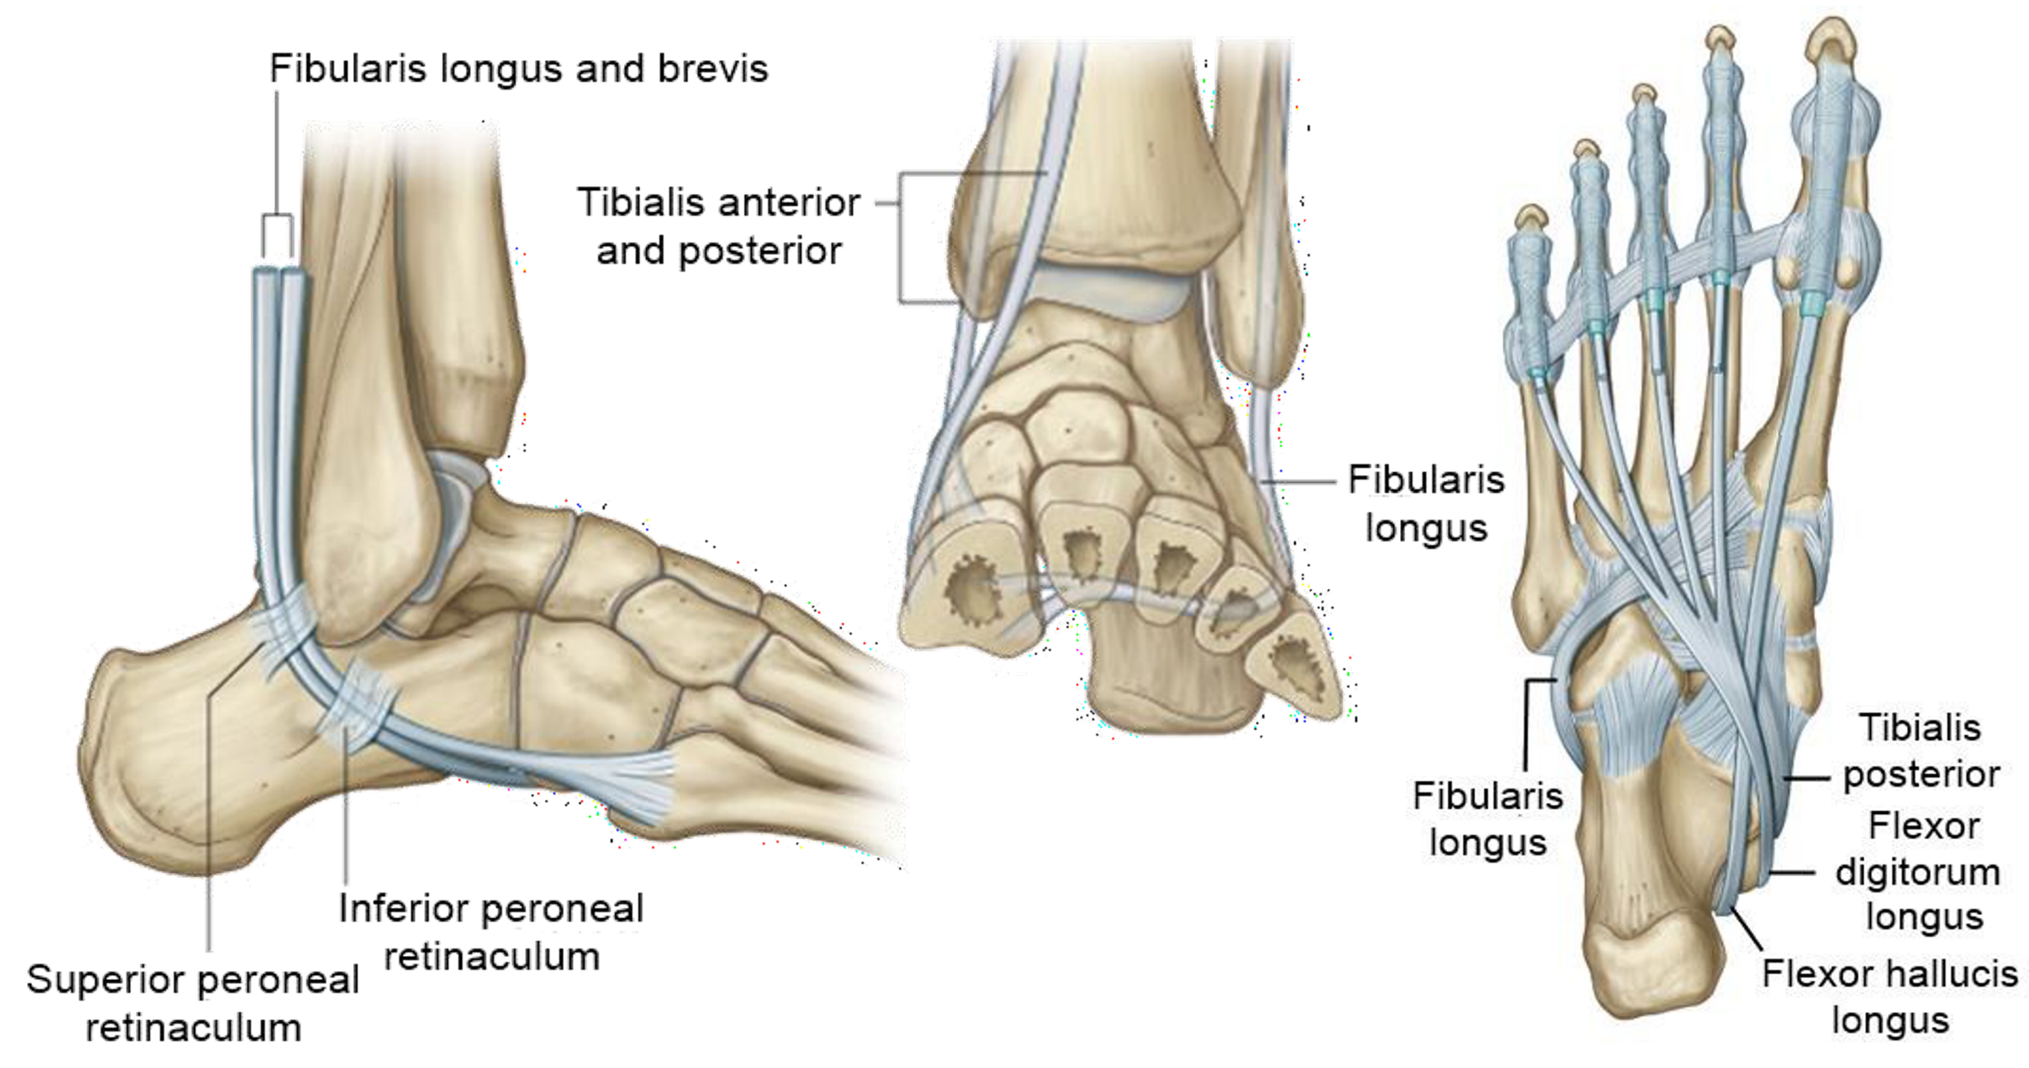
ARCH SUPPORT – TENDON

Slide 53
QUIZ

Slide 54
Muscles of the foot

Slide 55
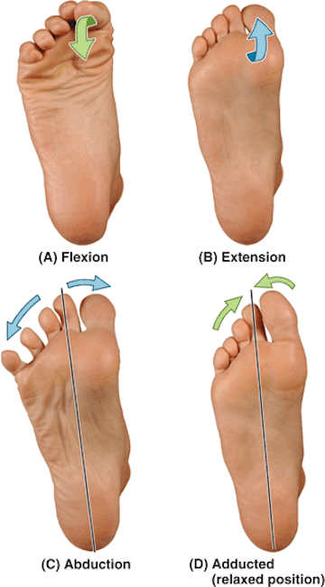
MOVEMENTS OF THE TOES
The metatarsalphalangeal joints permit:
  Extension
  Flexion
  Abduction
  Adduction

Slide 56
MOVEMENTS OF THE TOES
Extensors of the toes:
Extensor hallucis longus, extensor digitorum longus, extensor digitorum brevis, lumbricals
Abductors of the toes:
Abductor hallucis, abductor digiti minimi, dorsal interossei
Flexors of the toes:
Flexor hallucis longus, flexor hallucis longus, flexor digitorum longus, flexor digitorum brevis, flexor digiti minimi, lumbricals
Adductors of the toes:
Adductor hallucis, plantar interossei

Slide 57
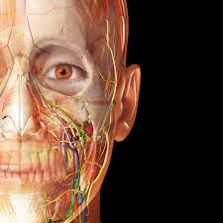
VISIBLE BODY

Slide 58
QUIZ

Slide 59
Neurovascular supply of the foot

Slide 60
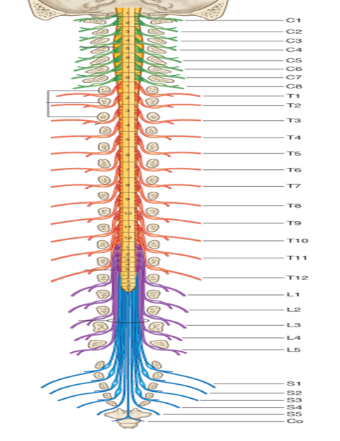
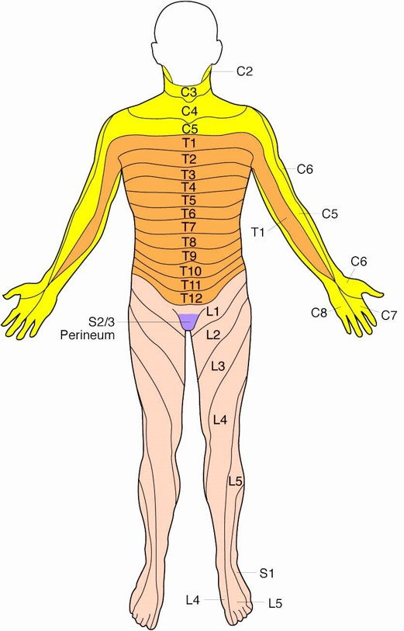
NERVE ROOTS
Location of neurological signs and/or symptoms can relate to a specific spinal level

Slide 61

DERMATOME INNERVATION

Slide 62

CUTANEOUS INNERVATION

Slide 63

ARTERIAL SUPPLY

Slide 64

VENOUS SUPPLY

Slide 65
SUMMARY
If you know your basic anatomical terminology, learning region-specific anatomy is far easier!
Be logical when learning anatomy – bones → joints → movements → muscles

Slide 66
ANY QUESTIONS?

